Slide 1

Geometry Dash Auto-Player
Rajat Sethi – Final AI Project

Slide 2
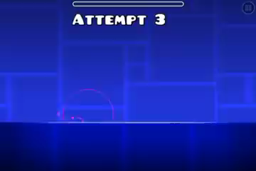
The Game

Slide 3


Game Mechanisms
0 – No Movement
1 - Movement

Slide 4
Movement List
Initial List
- [0, 0, 0, 0, 0, 0, 0, 0, 0, 0, 0, 0, 0, 0]
Algorithm
Evolved List
- [0, 1, 0, 0, 1, 1, 0, 0, 0, 1, 0, 1, 0, 0]

Slide 5
The Binary System
Death Frame
If Player has Died:
- [0, 1, 0, 0, 1, 1, 0, 0, 0, 1, 0, 1, 0, 0]
“0100110001”
305
+1 Decimal
306
“0100110010”
- [0, 1, 0, 0, 1, 1, 0, 0, 1, 0, 0, 1, 0, 0]

Slide 6
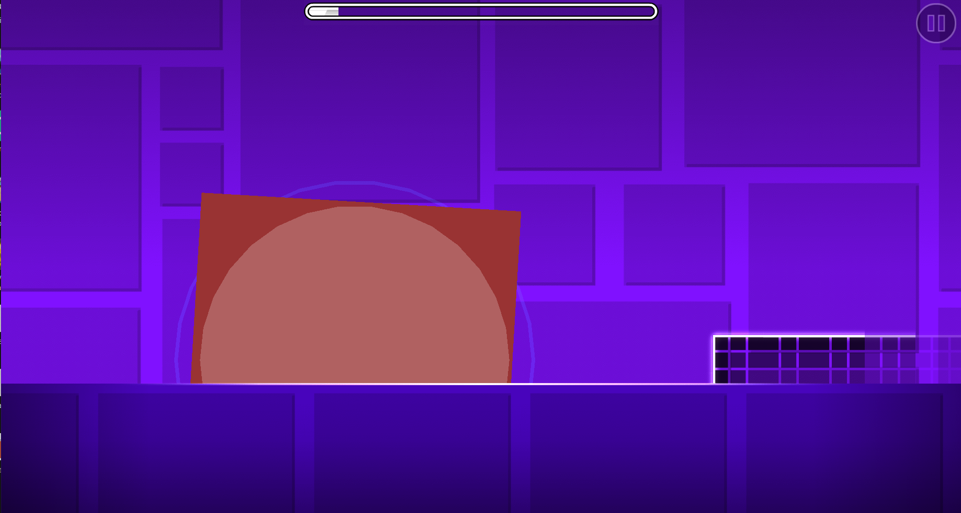
Recognizing Player Death – Custom Effect

